Slide 1
Term Deposit Subscription Prediction with Machine Learning
K G Suthirabinav July 31, 2023

Slide 2
Overview
In this project, I aimed to address the challenges faced by banking telecallers when promoting term deposit plans. Leveraging machine learning algorithms and historical customer data, our goal was to accurately predict the likelihood of customers subscribing to these plans. By empowering telecallers with targeted insights, we aimed to enhance the efficiency and effectiveness of sales calls, ultimately leading to improved customer engagement and higher subscription rates.

Slide 3
Data Overview
The dataset consists of various attributes related to customers, including age, job type, marital status, education, credit default status, account balance, housing and personal loan status, communication method, and contact history.
Additionally, it includes features such as the day and month of last contact, call duration, number of contacts during the campaign, days since the last contact from a previous campaign, number of previous contacts, and the outcome of the previous marketing campaign.
The target variable, 'y_bool,' indicates whether the customer subscribed to the term deposit plan or not.

Slide 4
Variables Used for Analysis:
VARIABLE | DESCRIPTION | TYPE
Age | The age of the customer | Numeric
Marital | The type of job the customer has | Categorical
Education | The marital status of the customer | Categorical
Default | The educational background of the customer | Categorical
Balance | Whether the customer has a credit default | Categorical
Housing | The current balance in the customer's account | Categorical
VARIABLE | DESCRIPTION | TYPE
Contact | The method of communication used to contact the customer | Numeric
Day | The day of the month when the customer was last contacted | Numeric
Month | The month of the year when the customer was last contacted | Categorical
Duration | The duration (in seconds) of the last contact with the customer | Numeric
Campaign | The number of contacts performed during this campaign for the customer | Numeric
P_outcome | The outcome of the previous marketing campaign | Categorical
Loan | Whether the customer has a personal loan | Categorical

Slide 5
Data Cleaning and Preprocessing Steps
Data Cleaning: The dataset was thoroughly checked for any missing values (null values). Fortunately, there were no null values, which eliminated the need for imputation.
Outlier Removal: Outliers, if any, were identified and removed to ensure that they do not unduly influence the model's performance and predictions.
Data Transformation: Categorical variables, such as job, marital status, education, default, housing, loan, contact, and month, were transformed using label encoding to convert them into numeric form suitable for machine learning algorithms.
Feature Scaling: Numerical features, such as age, balance, day, duration, campaign, and poutcome, were standardized using feature scaling to bring them to a similar scale, preventing any single feature from dominating the model training process.
Target Variable Encoding: The target variable, 'y_bool' (indicating whether the customer subscribed to the term deposit plan or not), was converted to binary format ('yes' or 'no').

Slide 6
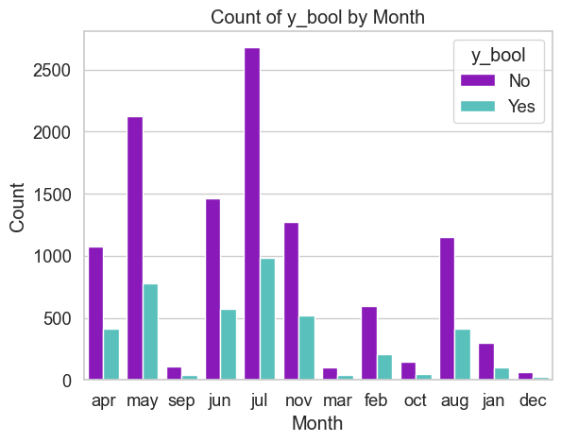
Visualizations
The countplot indicates that the months of July and May have the highest number of customer contacts during the marketing campaign.

Slide 7
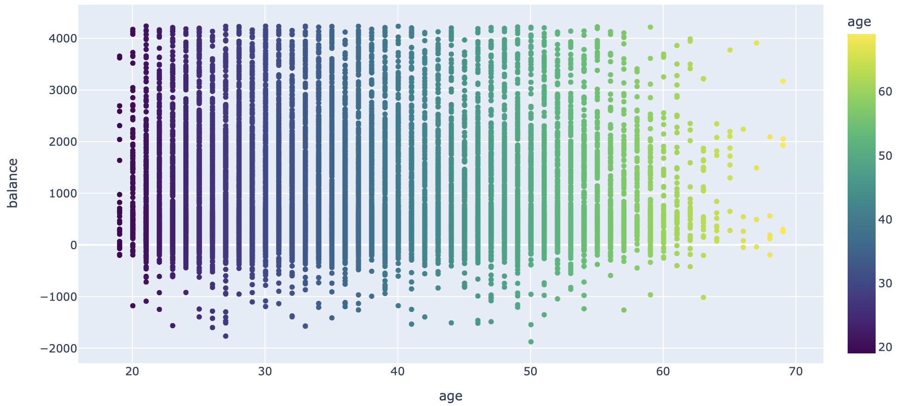
Visualizations
Scatter plot for Age and Balance :
Customers of age 60 has comparatively has less account balance than the rest of the customers

Slide 8
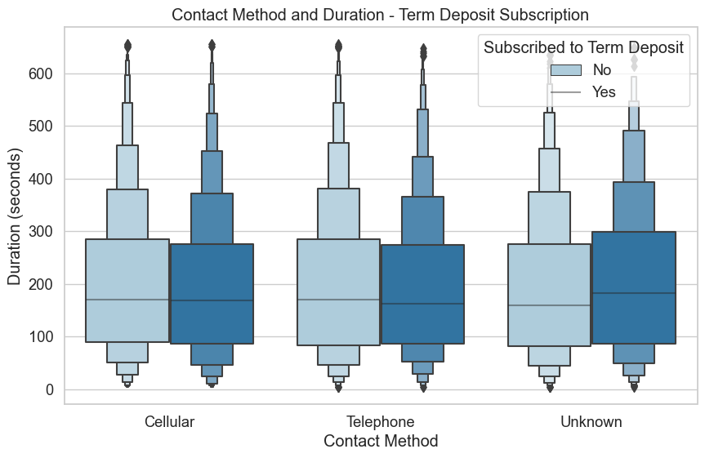
Visualizations
The Boxen plot reveals that the majority of call durations for the different contact methods fall within the range of 100 to 300 seconds.

Slide 9
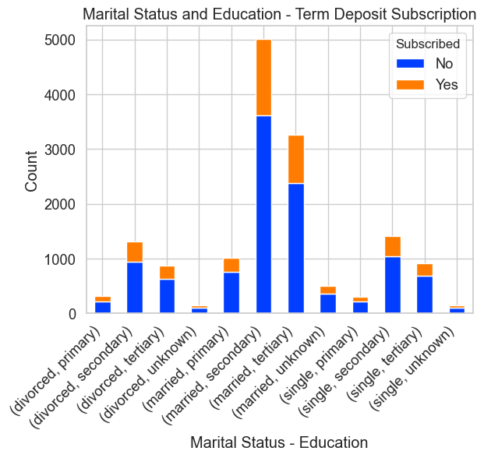
Visualizations
The plot reveals that married customers with tertiary and secondary education levels have the highest term deposit subscriptions.
This suggests that individuals with higher education levels are more likely to subscribe to the term deposit plan.
Targeting such demographics can enhance subscription rates.

Slide 10
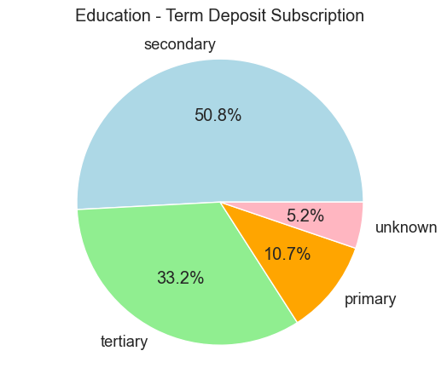
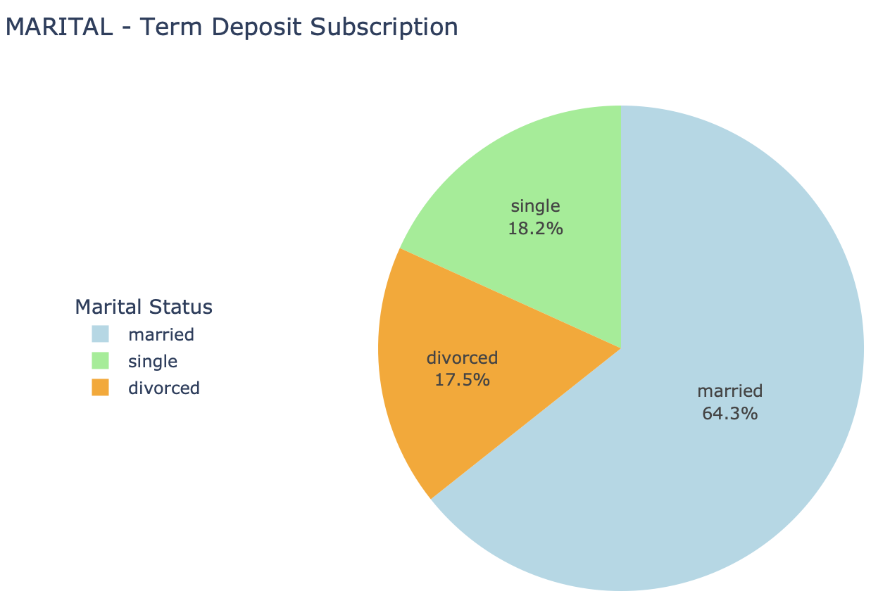
Visualizations
The pie chart illustrates the distribution of education levels for term deposit subscribers. Secondary education stands out with the highest percentage, making up 50.8% of the subscribers.
The pie chart displays the marital status distribution among term deposit subscribers. The majority, 64.3%, are married individuals
;

Slide 11
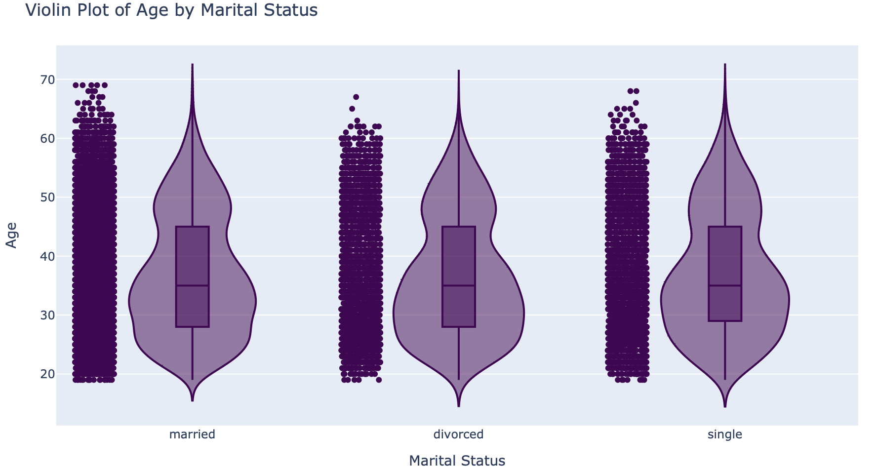
Visualizations
The Violin reveals that the majority of individuals fall within the age range of 20 to 4

Slide 12
Label Encoding
Categorical variables in machine learning models need to be converted into numerical format for effective processing. Label encoding is a technique that transforms categorical data into numerical labels. It assigns a unique integer to each category, allowing algorithms to interpret and process the data accurately.
The code snippet df['education'] = label_encoder.fit_transform(df['education']) demonstrates how to apply label encoding using scikit-learn's LabelEncoder class, which automatically assigns numeric labels to different education categories in the DataFrame df.

Slide 13
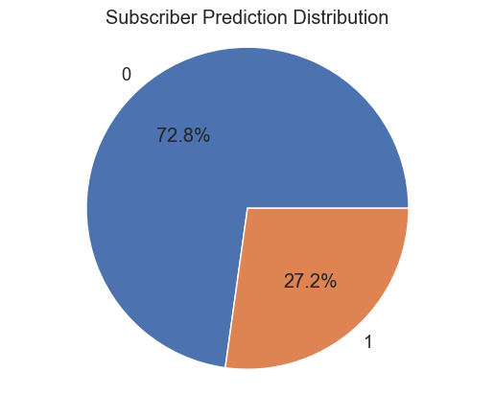
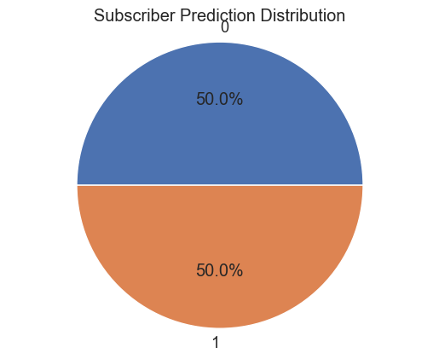
Balancing data
The dataset was initially imbalanced, with a distribution of 72.8% in one class and 27.2% in the other.
To address this issue, Synthetic Minority Over-sampling Technique (SMOTE) was employed, resulting in a balanced dataset with equal representation of both classes, each accounting for 50%. SMOTE generates synthetic samples for the minority class, effectively mitigating class imbalance.
This balanced dataset is crucial for training machine learning models, as it ensures unbiased learning and better generalization performance for predicting both classes accurately.

Slide 14
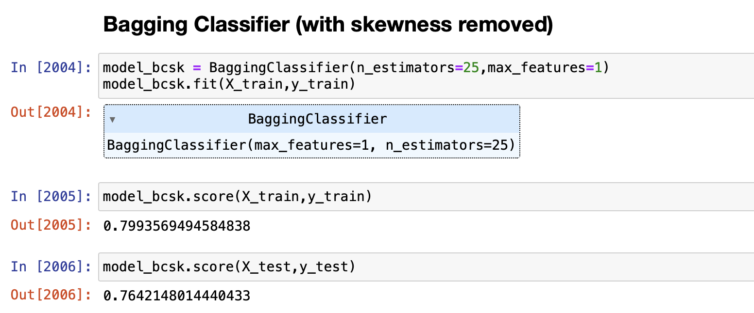
Model Building
The preprocessed data is split into training and testing sets. The machine learning models listed in the "MODELS PERFORMED" section are trained on the training set using various algorithms, such as Logistic Regression, Bagging Classifier, Support Vector Classifier (SVC), Random Forest, Gradient Boosting Classifier, GaussianNB, and Decision Tree Classifier.

Slide 15
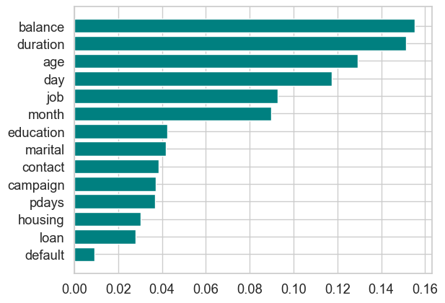
Feature Selection
A Random Forest classifier (rf) is trained on the dataset after eliminating the "previous" and "pdays" features (columns) using feature importance analysis.
The code then utilizes Recursive Feature Elimination with Cross-Validation (RFECV) to select the most relevant features. The selected features are determined based on their ability to improve model performance.
This process helps to optimize the model's predictive capabilities by focusing on the most informative attributes, leading to enhanced accuracy and generalization.

Slide 16
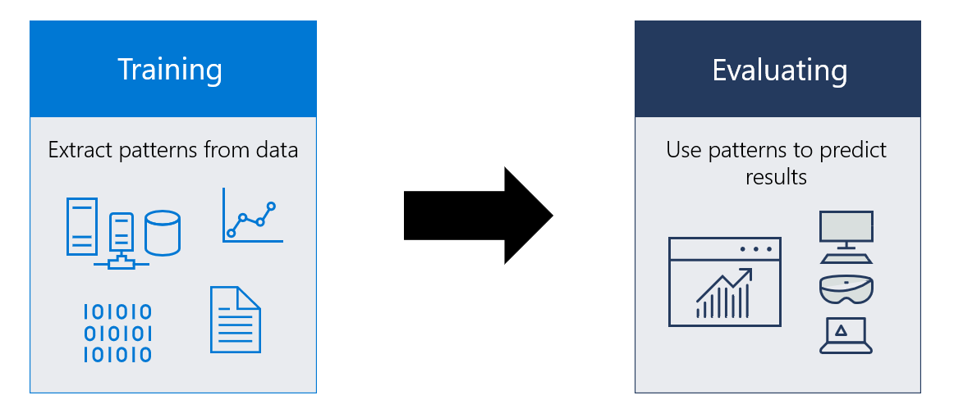
Performing Classification Models
I’ve utilized various machine learning models for classification:
Logistic Regression
BaggingClassifier
Support Vector Machine (SVC)
RandomForest
GradientBoostingClassifier
GaussianNB
Decision Tree Classifier
By evaluating these models, we identified their strengths and weaknesses, guiding us to select the most effective approach for our dataset. This enabled us to optimize classification performance and make informed decisions for better results.

Slide 17
Scaled Approach
DATA IMPUTATION:
First scaled the features of the dataset using z-score normalization.
After splitting the data into training and testing sets, we applied the GradientBoostingClassifier with specified hyperparameters.
To handle missing values, we utilized the SimpleImputer with the median strategy to replace NaN values in the training data.
The model was then trained on the imputed training data, resulting in a training accuracy of 0.7507 and a test accuracy of 0.7050. The imputation process improved the model's generalization on unseen data, contributing to better performance on the test set

Slide 18
Scaled Approach
-> MIN MAX SCALAR
Data Scaling: The feature data is scaled using MinMaxScaler to ensure all features are on a similar scale, enhancing model performance.
Train-Test Split: The dataset is split into training and test sets (80% - 20%) for model evaluation.
Gradient Boosting Classifier: A GradientBoostingClassifier model is initialized with specific hyperparameters and trained on the scaled training data.
The resulting model_gbc_scm can be used for predictions or further evaluation. The combination of data scaling and Gradient Boosting enhances the model's accuracy and robustness.

Slide 19
Model Evaluation
| Model | Accuracy | Precision | Recall | F1-score |
|-----------------------------------------—--|---------------|-------------|------------|-------------|
| Logistic Regression | 0.6511 | 0.6411 | 0.6715 | 0.6560 |
| BaggingClassifier | 0.6549 | 0.6523 | 0.6497 | 0.6510 |
| SVC | 0.5188 | 0.5144 | 0.5134 | 0.5139 |
| RandomForest | 0.7152 | 0.7613 | 0.6191 | 0.6829 |
| GradientBoostingClassifier | 0.7050 | 0.7291 | 0.6437 | 0.6838 |
| GaussianNB | 0.6236 | 0.5891 | 0.7941 | 0.6764 |
| DECISION TREE CLASSIFIER | 0.6640 | 0.6704 | 0.6328 | 0.6510 |
| Bagging Classifier (no skewness ) | 0.7125 | 0.7409 | 0.6511 | 0.6913 |
The trade-offs between accuracy, precision, recall, and F1-score should be carefully considered when selecting the most suitable model for the specific use case.
RandomForest achieved the highest accuracy (71.52%) and precision (76.13%), while GaussianNB had the highest recall (79.41%). The choice of the best model depends on the specific use case and the importance of accuracy, precision, or recall. Trade-offs must be considered when selecting the most suitable model.

Slide 20
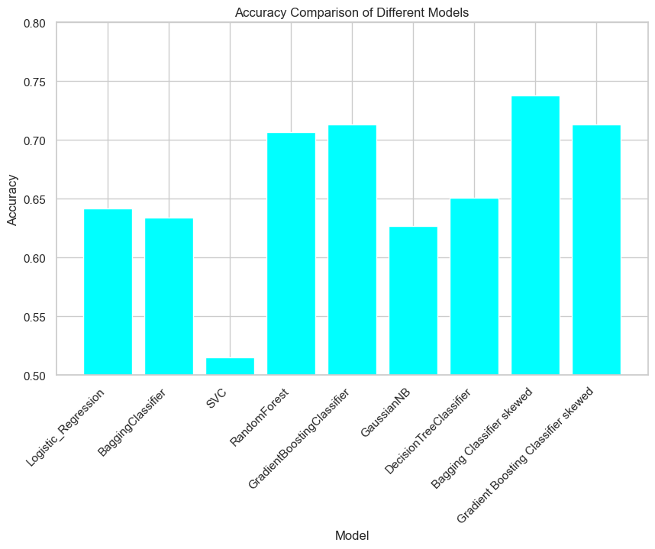
Model Evaluation
RandomForest, Bagging Classifier (no skewness), and GradientBoostingClassifier seem to be the top-performing models in terms of accuracy and balanced precision-recall trade-off. On the other hand, SVC and GaussianNB have relatively lower accuracy and might require further tuning or investigation to improve their performance.

Slide 21
Deployment
The Django project "caps" consists of the main settings.py file for configuration, urls.py for routing, and other related files.
The "subs" app contains views.py for handling requests, models.py for defining data models, and other components.
The "index.html" and "result.html" templates provide user interfaces. A Jupyter notebook file is used for analysis and experimentation.
The "model.joblib" file in the "savedModels" directory stores the saved machine learning model.
The "manage.py" script facilitates managing the project and running the development server.

Slide 22
Deployment
WHY DJANGO OVER FLASK
Django is preferred over Flask because it is a full-featured and robust web framework that includes many built-in functionalities, making development faster and easier.
Flask, on the other hand, is more lightweight and flexible, offering greater control but requiring more manual configuration and additional packages for certain features.
The choice depends on the project's complexity and the developer's preference for convenience or customization.

Slide 23
Thank You

